Slide 1
Laptop Reviews
Your best decision is our will

Slide 2
Team member
Supervisor: Mr. Kiều Trọng Khánh
Võ Thị Minh Châu
Nguyễn Văn Hơn (Dropped out)
Đinh Hữu Toàn
Nguyễn Mạnh Khương

Slide 3
Outline
Scenario problem
Our solution
Demonstration
Advantages and disadvantages of current solution
Questions and answers
Future Plans

Slide 4




Scenario problem
Notes:
- ngta can biet thong tin de lam gi do, de tra cuu, de so sanh de tim hieu, mua...

Slide 5
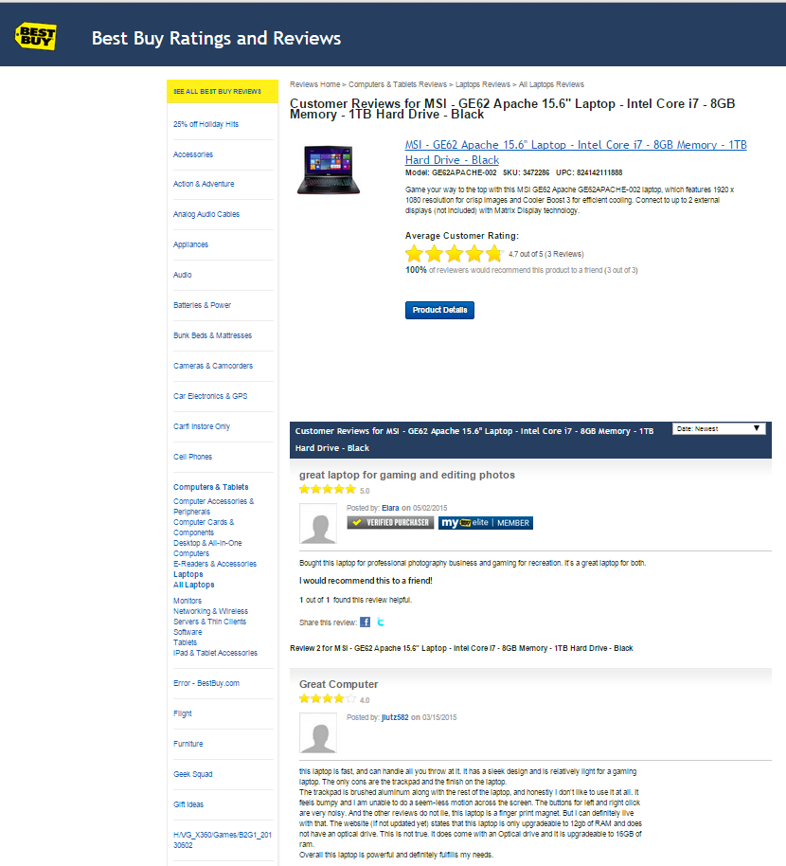
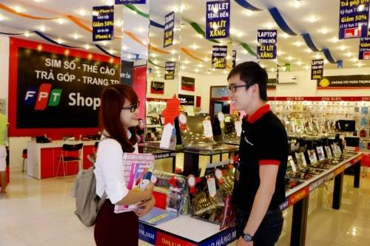
Scenario problem
Notes:
Search online các website
Nếu có thời gian thì đi ra các cửa hàng để tham quan và lấy thông tin từ đó

Slide 6
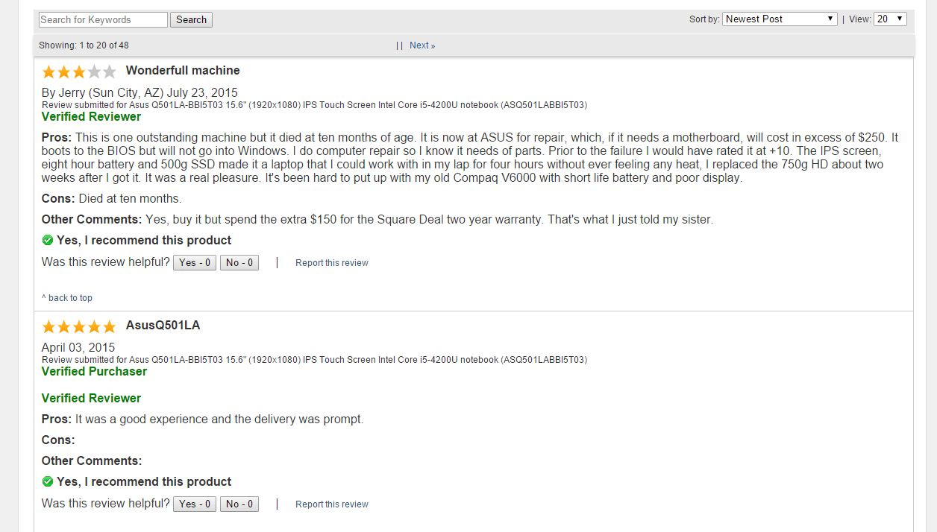
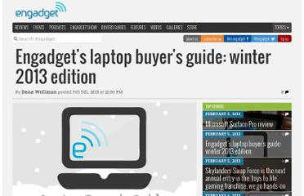
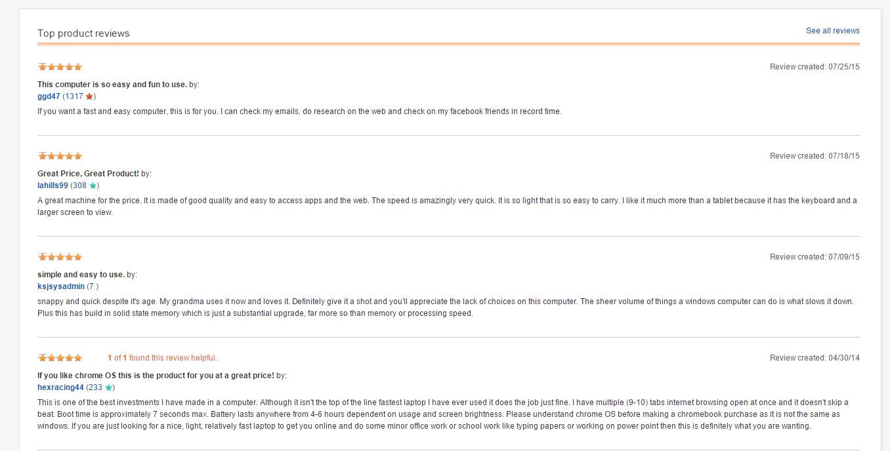
Scenario problem
Take lots of time to search for trusted websites and read all the reviews
1
Notes:
Các website không đáng tin cậy
Thông tin không chính thống, mông lung

Slide 7
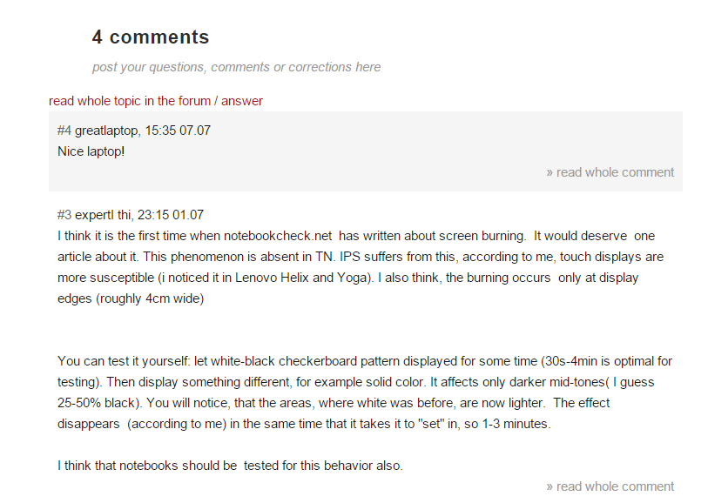

Scenario problem
2
Some reviews may be useless or not relevant.
Notes:
Các bình luận không liên quan
Bình luận không chuẩn, quá ngắn, quá dài và nhiều khi chỉ là một lời cảm thán mang nặng tính cá nhân

Slide 8

Scenario problem
Hard to remember exactly the information these supermarkets provide
3
Notes:
1. Nếu đi ra cửa hàng thì khó nhớ thông tin

Slide 9

Scenario problem
1
2
3
What is the best way to have good reviews?
Notes:
Tìm kiếm thông tin từ những trang web uy tín
Tiến hành làm sạch và chuẩn hóa các bình luận, để người dùng có thể tìm được thông tin nhanh chóng và chính xác

Slide 10
Our Solution

Slide 11


Our solution
Find trusted websites

Slide 12



Our solution
Find trusted websites
Collect information

Slide 13


Our solution
Find trusted websites
Collect information
Standardize comments
Notes:
=> giới thiệu C trình bày cách lấy dữ liệu

Slide 14
Collect Data

Slide 15
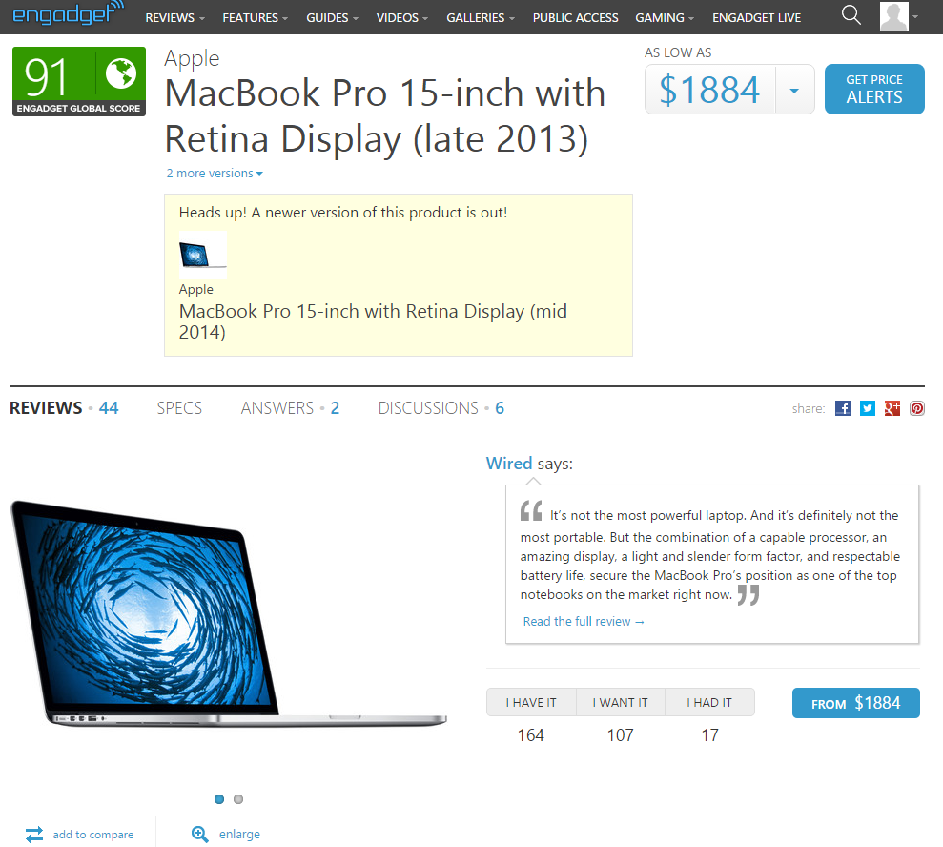
Collect Data Step 1: Find trusted website
http://www.engadget.com/
Notes:
1. de lay thong tin laptop, chung toi phai tim trang web va dua thong tin do ve
chung toi tim dc trang web engadget, day la 1 trang web co thong tin ve laptop kha chuan.

Slide 16




Collect Data Step 1: Find trusted website
Comments are approved before publishing.
Notes:
chung toi quyet dinh dung trang web tieng anh boi vi du sao tieng anh cung tot hon tieng viet
ngoai engadget con lay them 2 trang nua, vi nhung trang nay khi cmt thi phai cho staff duyet

Slide 17

Collect Data
How to get data from this site?
Notes:
va cau hoi dat ra la lam sao de lay dc thong tin tu trang web nay ve

Slide 18
Collect Data
Notes:
va cau hoi dat ra la lam sao de lay dc thong tin tu trang web nay ve

Slide 19
Collect Data
Notes:
va cau hoi dat ra la lam sao de lay dc thong tin tu trang web nay ve

Slide 20
Collect Data
Notes:
va cau hoi dat ra la lam sao de lay dc thong tin tu trang web nay ve

Slide 21
Collect Data
Notes:
va cau hoi dat ra la lam sao de lay dc thong tin tu trang web nay ve

Slide 22
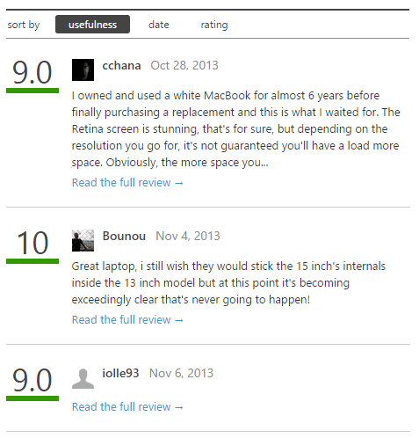
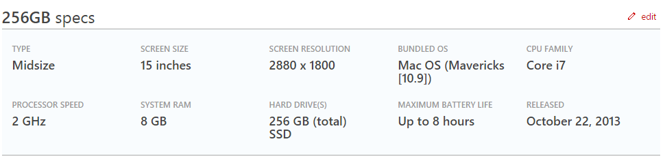
Collect Data

Slide 23
Collect Data

Slide 24
Collect Data

Slide 25
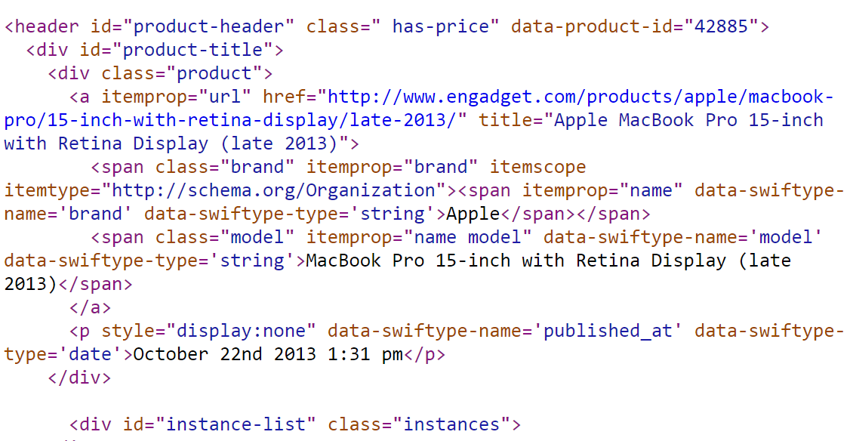
Collect Data
Notes:
show trang engadget len, cho thay trang nay co nhung thong tin: ten, brand, desc, cmt...
chup hinh trang engadget dang html. de parse dc trang html nay thi co solution gi, gap van de gi
Phan tich ra, phong ra tu trang 17. VD ra

Slide 26
Collect Data
Notes:
show trang engadget len, cho thay trang nay co nhung thong tin: ten, brand, desc, cmt...
chup hinh trang engadget dang html. de parse dc trang html nay thi co solution gi, gap van de gi
Phan tich ra, phong ra tu trang 17. VD ra

Slide 27
Collect Data
<span class="model" itemprop="name model" data-swiftype-name='model' data-swiftype-type='string'>MacBook Pro 15-inch with Retina Display (late 2013)</span>
Notes:
show trang engadget len, cho thay trang nay co nhung thong tin: ten, brand, desc, cmt...
chup hinh trang engadget dang html. de parse dc trang html nay thi co solution gi, gap van de gi
Phan tich ra, phong ra tu trang 17. VD ra

Slide 28
Collect Data
Libraries support parsing data:
Selenium
vs
HtmlAgilityPack

Slide 29

Collect Data
Libraries support parsing data:
Selenium
vs
HtmlAgilityPack
Create
simulator browser

Slide 30

Collect Data
Libraries support parsing data:
Selenium
vs
HtmlAgilityPack
Create
simulator browser
Parse data

Slide 31
Collect Data
Libraries support parsing data:
Selenium
vs
HtmlAgilityPack
Create
simulator browser
Parse data
Parse data

Slide 32

Collect Data
Libraries support parsing data:
Selenium
vs
HtmlAgilityPack
Create
simulator browser
Parse data
Decrease speed
Parse data

Slide 33
Collect Data
Libraries support parsing data:
Selenium
vs
HtmlAgilityPack
Create
simulator browser
Parse data
Decrease speed
Parse data

Slide 34

Collect Data

Slide 35

Collect Data
Take url
Remove script

Slide 36

Collect Data
Take url
Download
Remove script

Slide 37

Collect Data
Take url
Download
Remove script
Display

Slide 38
Collect Data
Take url
Download
Remove script
Display
xPath
Get
Notes:
Inspect ? => s

Slide 39
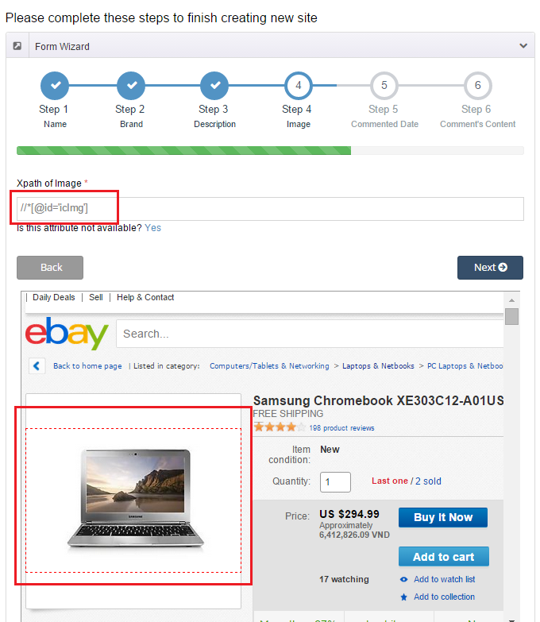

Slide 40
How to get xpath?

Slide 41
Collect Data
Step 1: From clicked node

Slide 42
Collect Data
Step 1: From clicked node
Step 2: Get parent node

Slide 43
Collect Data
Step 1: From clicked node
Step 2: Get parent node
Step 3: Stop when meeting “HTML” or “ID” node

Slide 44
Collect Data
Step 1: From clicked node
Step 2: Get parent node
Step 3: Stop when meeting “HTML” or “ID” node
Step 4: Take xPath

Slide 45
Collect Data
Step 1: From clicked node
Step 2: Get parent node
Step 3: Stop when meeting “HTML” or “ID” node
Step 4: Take xPath
Step 5: Get data

Slide 46

Collect Data
System

Slide 47

Collect Data
Provide
System
Tool

Slide 48

Collect Data
Provide
Use
System
Tool
Staff

Slide 49
Collect Data
Provide
Use
System
Tool
Staff
Get
xPath

Slide 50
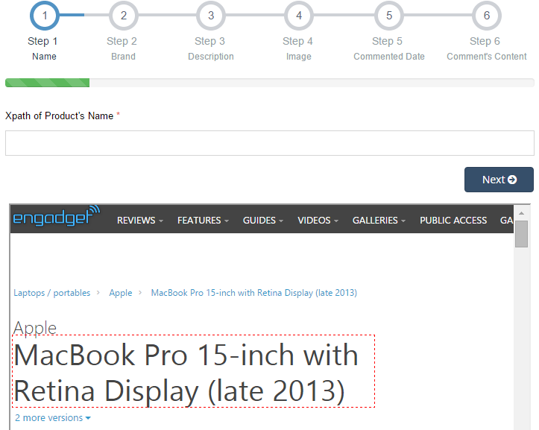
Step 1, 2 & 3: Get parent node, stop when meeting “html” or “id” node

Slide 51
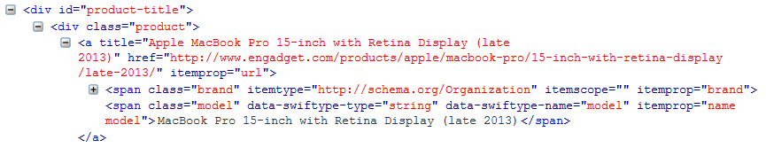
Step 1, 2 & 3: Get parent node, stop when meeting “html” or “id” node

Slide 52
Step 1, 2 & 3: Get parent node, stop when meeting “html” or “id” node

Slide 53
Step 1, 2 & 3: Get parent node, stop when meeting “html” or “id” node
span[2]

Slide 54
Step 1, 2 & 3: Get parent node, stop when meeting “html” or “id” node
Clicked node
span[2]

Slide 55
Step 1, 2 & 3: Get parent node, stop when meeting “html” or “id” node
Clicked node
span[2]

Slide 56
Step 1, 2 & 3: Get parent node, stop when meeting “html” or “id” node
Clicked node
span[2]

Slide 57
Step 1, 2 & 3: Get parent node, stop when meeting “html” or “id” node
Clicked node
a /
span[2]

Slide 58
Step 1, 2 & 3: Get parent node, stop when meeting “html” or “id” node
Parent node
Clicked node
a /
span[2]

Slide 59
Step 1, 2 & 3: Get parent node, stop when meeting “html” or “id” node
Parent node
Clicked node
a /
span[2]

Slide 60
Step 1, 2 & 3: Get parent node, stop when meeting “html” or “id” node
Parent node
Clicked node
a /
span[2]

Slide 61
Step 1, 2 & 3: Get parent node, stop when meeting “html” or “id” node
Parent node
Clicked node
div[1] /
a /
span[2]

Slide 62
Step 1, 2 & 3: Get parent node, stop when meeting “html” or “id” node
Parent node
Clicked node
div[1] /
a /
span[2]

Slide 63
Step 1, 2 & 3: Get parent node, stop when meeting “html” or “id” node
Parent node
Clicked node
div[1] /
a /
span[2]

Slide 64
Step 1, 2 & 3: Get parent node, stop when meeting “html” or “id” node
Parent node
Clicked node
div[1] /
a /
span[2]

Slide 65
Step 1, 2 & 3: Get parent node, stop when meeting “html” or “id” node
Parent node
Clicked node
*[@id='product-title']/
div[1] /
a /
span[2]

Slide 66
Step 1, 2 & 3: Get parent node, stop when meeting “html” or “id” node
“id” node
Parent node
Clicked node
*[@id='product-title']/
div[1] /
a /
span[2]

Slide 67
Step 1, 2 & 3: Get parent node, stop when meeting “html” or “id” node
“id” node
Parent node
Clicked node
//
*[@id='product-title']/
div[1] /
a /
span[2]

Slide 68
Step 1, 2 & 3: Get parent node, stop when meeting “html” or “id” node
“id” node
Parent node
Clicked node
//
*[@id='product-title']/
div[1] /
a /
span[2]
//*[@id='product-title']/div[1]/a/span[2]

Slide 69
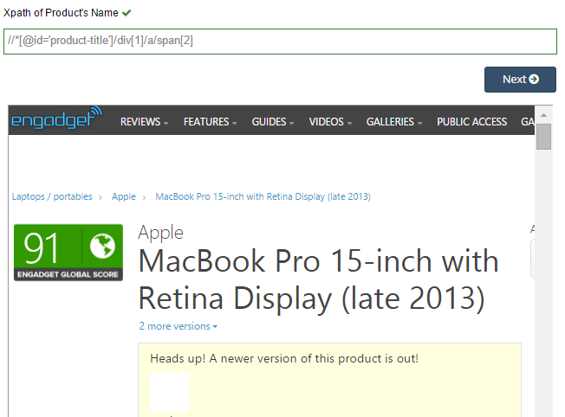
Step 4&5: Take xPath and Get data

Slide 70
Step 4&5: Take xPath and Get data

Slide 71
Step 4&5: Take xPath and Get data
MacBook Pro 15-inch with Retina Display (late 2013)

Slide 72
Step 4&5: Take xPath and Get data
MacBook Pro 15-inch with Retina Display (late 2013)
Product
Name

Slide 73
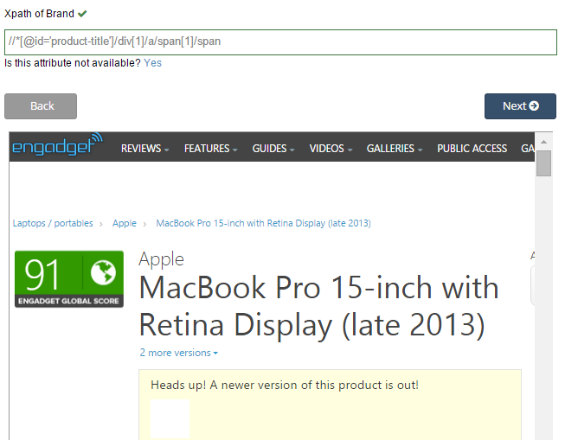
Step 4&5: Take xPath and Get data
Apple
Product
Name
Brand

Slide 74
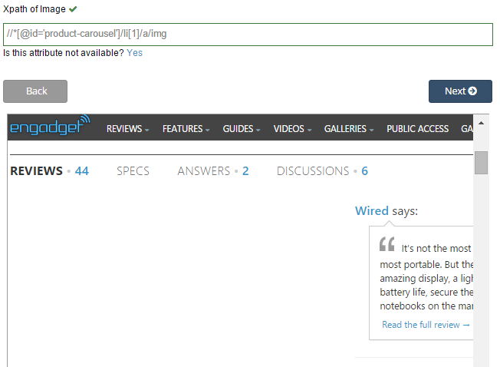


Step 4&5: Take xPath and Get data
Product
Name
Brand
Image

Slide 75
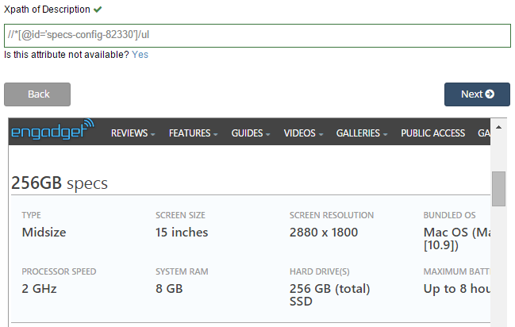
Step 4&5: Take xPath and Get data
Type: Midsize
Screen size: 15 inches
…
Product
Name
Brand
Image
Description

Slide 76
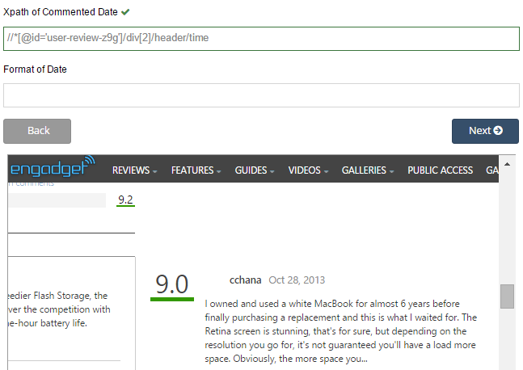
Step 4&5: Take xPath and Get data
Oct 28, 2013
Product
Name
Brand
Image
Description
Comment’s date

Slide 77
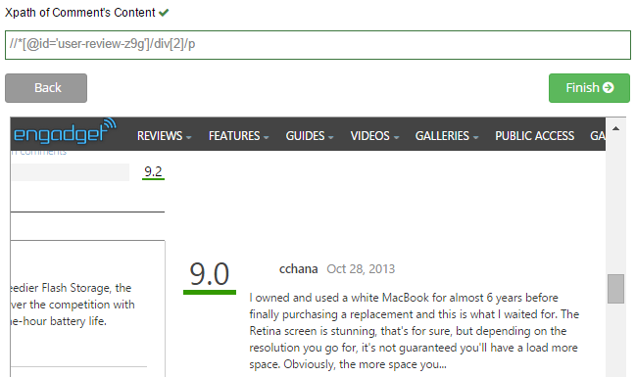
Step 4&5: Take xPath and Get data
I owned and used a white MacBook for almost 6 years before finally purchasing a replacement…
Product
Name
Brand
Image
Description
Comment’s date
Comment’s content

Slide 78
Collect Data
We have these entities
Product
Url
Name
Brand
Description
Image
Comment’s date
Comment’s content

Slide 79
Collect Data
We have these entities
Product
Url
Name
Brand
Description
Image
Last comment’s date
Comment’s content

Slide 80
Collect Data
We have these entities
Product
Site
Url
Name
Brand
Description
Image
Last comment’s date
Comment’s content
Domain
Name’s xpath
Brand’s xpath
Description’s xpath
Image’s xpath
Date’s xpath
Content’s xpath

Slide 81
Collect Data
We have these entities
Product
Site
Url
Name
Brand
Description
Image
Last comment’s date
Comment’s content
Domain
Name’s xpath
Brand’s xpath
Description’s xpath
Image’s xpath
Date’s xpath
Content’s xpath
0..*
1..*
2 different websites have a laptop with different information.
Notes:
trong qua trinh collection du lieu, chung toi da nhan thay dc 1 dieu: 2 trang web khac nhau voi cung 1 laptop co thong tin khac nhau. vi vay chung toi moi nghi ra cach
problem

Slide 82






Collect Data

Slide 83

Collect Data

Slide 84
Collect Data
Alias Product

Slide 85
Collect Data
We have these entities
Product
Site
Brand
Description
Image
Domain
Name’s xpath
Brand’s xpath
Description’s xpath
Image’s xpath
Date’s xpath
Content’s xpath
0..*
1..*
Alias Product
Url
Name
Last comment’s date
Content’s xpath

Slide 86
Detect Duplicated Product

Slide 87
Detect Duplicated Product String Comparision

Slide 88


Detect Duplicated Product String Comparison
MacBook Air 2015
MacBook Air Retina 2015

Slide 89
Detect Duplicated Product String Comparison
Step 1: Split into a list of character pairs

Slide 90
Detect Duplicated Product String Comparison
Step 1: Split into a list of character pairs
Step 2: Count how many adjacent character pairs

Slide 91
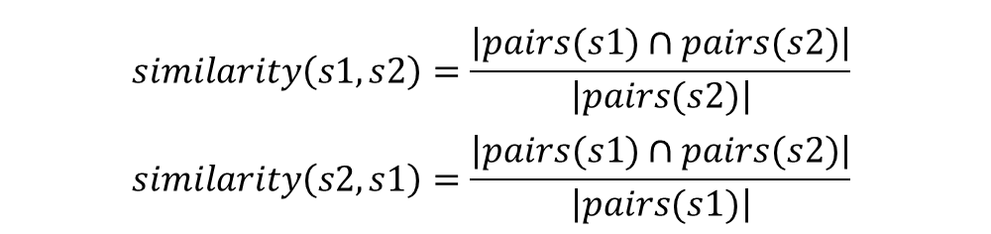
Detect Duplicated Product String Comparison
Step 1: Split into a list of character pairs
Step 2: Count how many adjacent character pairs
Step 3: Calculate matching percent
$$similarity\left(s1,s2\right)=\frac{\left|pairs(s1)∩pairs(s2)\right|}{\left|pairs(s2)\right|}$$
$$similarity\left(s2,s1\right)=\frac{\left|pairs(s1)∩pairs(s2)\right|}{\left|pairs(s1)\right|}$$

Slide 92
Detect Duplicated Product String Comparison
s1
s2
MacBook Air 2015
MacBook Air 2015 Retina

Slide 93
Detect Duplicated Product String Comparison
s1
s2
MacBook Air 2015
MacBook Air 2015 Retina
MACBOOK AIR 2015
MACBOOK AIR 2015 RETINA

Slide 94
Detect Duplicated Product String Comparison
s1
s2
MacBook Air 2015
MacBook Air 2015 Retina
MACBOOK AIR 2015
MACBOOK AIR 2015 RETINA
$$\left\{MA,AC,CB,BO,OO,OK,AI,IR,20,01,15\right\}$$
$$\left\{MA,AC,CB,BO,OO,OK,AI,IR,20,01,15,RE,ET,TI,IN,NA\right\}$$

Slide 95
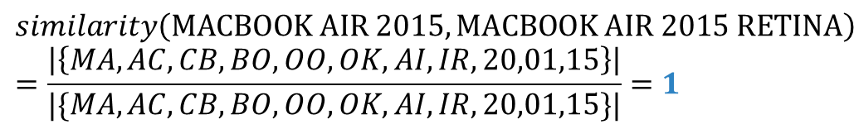
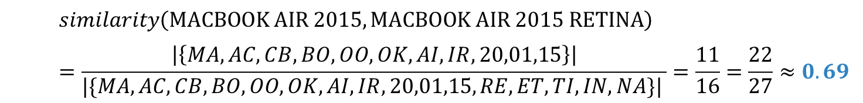
Detect Duplicated Product String Comparison
s1
s2
MacBook Air 2015
MacBook Air 2015 Retina
MACBOOK AIR 2015
MACBOOK AIR 2015 RETINA
$$\left\{MA,AC,CB,BO,OO,OK,AI,IR,20,01,15\right\}$$
$$\left\{MA,AC,CB,BO,OO,OK,AI,IR,20,01,15,RE,ET,TI,IN,NA\right\}$$
$$similarity\left(MACBOOK AIR 2015,MACBOOK AIR 2015 RETINA\right)=\frac{\left|\left\{MA,AC,CB,BO,OO,OK,AI,IR,20,01,15\right\}\right|}{|\{MA,AC,CB,BO,OO,OK,AI,IR,20,01,15,RE,ET,TI,IN,NA\}| }=\frac{11}{16}=\frac{22}{27}≈0.69$$
$$similarity\left(MACBOOK AIR 2015,MACBOOK AIR 2015 RETINA\right)=\frac{\left|\left\{MA,AC,CB,BO,OO,OK,AI,IR,20,01,15\right\}\right|}{|\{MA,AC,CB,BO,OO,OK,AI,IR,20,01,15\}|}=1$$
Notes:
Them ct min

Slide 96
Detect Duplicated Product String Comparison
$$min⁡(similarity\left(s1, s2), similarity(s2, s1)\right)=\min\left(0.69, 1\right)=0.69$$
similarity = 69 %

Slide 97

Detect Duplicated Product
New laptop

Slide 98

Detect Duplicated Product
New laptop
Data object
Database

Slide 99
Detect Duplicated Product
New laptop
Data object
Database

Slide 100
Detect Duplicated Product
New laptop
Data object
Database
is new
different brand
+
similarity < 40%
Notes:
Cùng brand và > 40%

Slide 101

Detect Duplicated Product
New laptop
Data object
Database
is new
different brand
+
similarity < 40%
true
Notes:
dk

Slide 102
Detect Duplicated Product
New laptop
Data object
Database
is new
false
different brand
+
similarity < 40%
true

Slide 103

Detect Duplicated Product
New laptop
Data object
Database
is new
false
different brand
+
similarity < 40%
true
save
Notes:
Giới thiệu T trình bày cách xử lý sp trùng

Slide 104











Handle Duplicated Product
Laptop 1
Laptop 2
Main
Alias
Database
Set Main Laptop
Staff
Save
Description
Description
74%
Comments
Comments
Laptop 1
Laptop 2
Main
Images
Images
Merge
Staff

Slide 105


Handle Duplicated Product
MacBook Pro 12' 2015
Notes:
Sau qua trinh parse, he thong tim duoc

Slide 106



Handle Duplicated Product
Database
MacBook Pro 12' 2015
MacBook (early 2015)
Notes:
… Sau do so voi db … sau do

Slide 107
Handle Duplicated Product
Database
MacBook Pro 12' 2015
MacBook (early 2015)
Notes:
Giong nhau

Slide 108
Handle Duplicated Product
Database
MacBook Pro 12' 2015
MacBook (early 2015)
Notes:
San pham chinh o db co id la …

Slide 109
Handle Duplicated Product
Database
MacBook Pro 12' 2015
MacBook (early 2015)
Notes:
Sau khi merge, san pham phu luu vao alias, co product id la id cua sp chinh, sp chinh se dc danh dau la main

Slide 110


Handle Duplicated Product – After merging
Main laptop name
Search
Main
Guest
Alias laptop name

Slide 111



Handle Duplicated Product
67%
Laptop 1
Laptop 2
Database
Description
Description
Save
Save
Comments
Comments
Images
Images
Split
New Laptop
New Laptop
Staff

Slide 112
Analyze Comment – Scenario problem

Slide 113


Scenario problem
In real life
How can system classify the comments?
Can we train it?
Notes:
Phân tích bình luận
Ở ngoài, có thể hiểu đc qua quá trình học tập từ nhỏ
Vậy làm sao máy hiểu

Slide 114

Scenario problem
Notes:
Ask English teacher

Slide 115
Analyze comment - Get words for database

Slide 116

Get words for database
WORDS
4.Other
1.Adjective/
Adverb
3.Noun
2.Verb
Meaning
Totally
Pros
Pros
Cons
Negative
Neutral

Slide 117

Get words for database
Word Name (Character of word)
Read
WORDS
Word Classes
(Adjective, Adverb,
Verb, Noun, Other)
Staff
Word Types
(Totally Pros, Pros, Cons,
Neutral, Negative)
Notes:
Nguoi nhan vien se doc 100 binh luan tu trang web uy tín
Sau đó lọc ra nội dung các từ. Nội dung này bao gồm: từ, từ loại và ý nghĩa của từ

Slide 118

Get words for database
Word Name
Word Types
Totally Pros, Pros, Cons, Neutral, Negative
Database
Word Classes
Adjective, Adverb, Verb, Noun, Other
Notes:
Sau đó lưu vào db

Slide 119



Get words for database
+
+
=
Database
System
Better Database
Notes:
Từ vốn từ có sẵn, kết hợp với lingoes để tìm các từ đồng nghĩa trái nghĩa của những từ trong vốn từ có sẵn, làm giàu vốn từ

Slide 120
Analyze comment

Slide 121

Analyze Comment
Read
Staff
Classify
System
WORDS
Better Database
Database

Slide 122



Analyze Comment
Classified
Comment
Negative
Negative
Flag
Collect and Split
into words
System
Totally Pros
WORDS
Compare
Database

Slide 123
Analyze Comment - Example
Although the speed is slow, I still love this laptop
System
“although” ,”the” , “speed”, ‘is”, “slow”, “I”, “still”, “love”, “this”, “laptop”
Split into words
Compare
Positive
Totally Pros
“love”
“slow”,
“love”
Database
Positive Comment

Slide 124

Analyze Comment – Check Adjectives/Adverbs
Good Flag
Neutral
Flag
Classified
Comment
Negative
Bad Flag
Negative
Flag
Collect and Split
into words
System
Adjective/Adverb
Pros/Cons
Neutral
WORDS
Compare
Database

Slide 125
Analyze Comment - Example
Despite slow speed, the screen is beautiful and the keyboard is good
System
“despite”, “slow”, “speed”, “the”, “screen”, “is”, “beautiful”, “and”, “the”, “keyboard”, “is”, “good”
Split into words
Pros
Compare
Good Flag
Adjective/Adverb
“good”
“slow”,
“beautiful”,
“good”
+
“beautiful”
Pros
Database
Positive
Good Flag
Adjective/Adverb
“slow”
<
Positive
comment
Cons
Bad Flag
Adjective/Adverb

Slide 126
Analyze Comment – Check Verbs
Good Flag
Neutral
Flag
Classified
Comment
Negative
Bad Flag
Negative
Flag
Collect and Split
into words
System
Verb
Pros/Cons
Neutral
WORDS
Compare
Database

Slide 127
Analyze Comment - Example
I don’t like this laptop
System
“I”, “don’t”, “like”, “this”, “laptop”
Split into words
Compare
Negative
Negative
Flag
“don’t”
“don’t”,
“like”
“like”
Pros
Database
Positive
Good Flag
Verb
Negative
comment

Slide 128
Analyze Comment – Check Nouns
Good Flag
Neutral
Flag
Classified
Comment
Negative
Bad Flag
Negative
Flag
Collect and Split
into words
System
Noun
Pros/Cons
Neutral
WORDS
Compare
Database

Slide 129
Analyze Comment - Example
I have no problem with this laptop
System
“I”, “have”, “no”, “problem”, “with”, “this”, “laptop”
Split into words
Compare
Negative
Negative
Flag
“no”
“no”,
“problem”
“problem”
Cons
Positive
Bad Flag
Noun
Database
Positive
comment

Slide 130
Analyze Comment - After checking all word’s classes
Neutral
Flag
Neutral Comment

Slide 131

Analyze Comment - Example
I bought this laptop a year ago
System
“I”, “bought”, “this”, “laptop”, “a”, “year“, “ago”
Split into words
Compare
“bought”
“bought”
Neutral
Neutral
Flag
Verb
Database
Neutral
comment

Slide 132

Analyze Comment - Summary
Classified
Words
Read and classify
words
Staff
System
Database
Classified
comments
Compare with
classified words
System
WORDS
Collect and Split
into words
Raw Comments

Slide 133
Our Solution - Summary

Slide 134


Our solution - Summary
Collect
Classify
System
Laptops with comments
Comments

Slide 135
Features
Search
Report comment
Recommend product
Classify comment
Import Excel
Get data from web
Mobile application

Slide 136
Demonstration

Slide 137
Demonstration
Scenario 1: Search laptop and report comment
Nam searches a product in the system and view detail of a product.
Then he reports a comment and staff will login to the system and handle it.
Nam

Slide 138

Demonstration
Scenario 1: Search laptop and report comment
Nam searches a product in the system and view detail of a product.
Then he reports a comment and staff will login to the system and handle it.
Search
Nam

Slide 139
Demonstration
Scenario 1: Search laptop and report comment
Nam searches a product in the system and view detail of a product.
Then he reports a comment and staff will login to the system and handle it.
Search
Read comments
Nam

Slide 140


Demonstration
Scenario 1: Search laptop and report comment
Nam searches a product in the system and view detail of a product.
Then he reports a comment and staff will login to the system and handle it.
Search
Read comments
Nam
Report

Slide 141
Demonstration
Scenario 1: Search laptop and report comment
Nam searches a product in the system and view detail of a product.
Then he reports a comment and staff will login to the system and handle it.
Search
Read comments
Nam
Report
Handle
Staff

Slide 142
Search and parse recommended product automatically

Slide 143
Search and parse recommended product automatically
order by report times

Slide 144
Search and parse recommended product automatically
order by report times

Slide 145

Search and parse recommended product automatically

Slide 146



Search and parse recommended product automatically

Slide 147

Search and parse recommended product automatically
Url of
recommended product
Search

Slide 148
Search and parse recommended product automatically
Url of
recommended product
Search
Parse data

Slide 149

Search and parse recommended product automatically
Url of
recommended product
Search
Parse data
Send email

Slide 150
Status of a recommended product
Status | Description
Pending | System cannot find this product automatically
Added | This product was added but the system cannot send notification
Duplicated | This product was parsed but it is similar to existed product
Sent | This product was added and the system sent email to guest
Cancel | This product is out of date for handling

Slide 151
Status of a recommended product
Case 1: System search and parse product automatically

Slide 152
Status of a recommended product
Case 1: System search and parse product automatically
Parse new product, send mail successfully
Sent

Slide 153
Status of a recommended product
Case 1: System search and parse product automatically
Parse new product, send mail successfully
Sent

Slide 154
Status of a recommended product
Case 1: System search and parse product automatically
Parse new product, send mail successfully
Parse new product,
send mail fail
Added
Sent

Slide 155
Status of a recommended product
Case 1: System search and parse product automatically
Parse new product, send mail successfully
Parse new product,
send mail fail
Added
Send mail successfully
Sent

Slide 156
Status of a recommended product
Case 1: System search and parse product automatically
Parse new product, send mail successfully
Parse new product,
send mail fail
Added
Send mail successfully
Sent
Parse duplicated product
Duplicated

Slide 157
Status of a recommended product
Case 1: System search and parse product automatically
Parse new product, send mail successfully
Parse new product,
send mail fail
Added
Send mail successfully
Sent
Send mail successfully
Parse duplicated product
Duplicated

Slide 158
Status of a recommended product
Case 1: System search and parse product automatically
Parse new product, send mail successfully
Parse new product,
send mail fail
Added
Send mail successfully
Sent
Merge/Split,
send mail fail
Send mail successfully
Parse duplicated product
Duplicated

Slide 159
Status of a recommended product
Case 2: Staff search and parse product
Pending

Slide 160
Status of a recommended product
Case 2: Staff search and parse product
Parse new product, send mail successfully
Pending
Parse new product,
send mail fail
Added
Send mail successfully
Sent
Merge/Split,
send mail fail
Send mail successfully
Parse duplicated product
Duplicated

Slide 161
Status of a recommended product
Case 2: Staff search and parse product
Parse new product, send mail successfully
Pending
Parse new product,
send mail fail
Added
Send mail successfully
Sent
Merge/Split,
send mail fail
Send mail successfully
Parse duplicated product
Duplicated
Out of date
Cancel

Slide 162
Status of a recommended product
Case 2: Staff search and parse product
Parse new product, send mail successfully
Pending
Parse new product,
send mail fail
Added
Send mail successfully
Sent
Merge/Split,
send mail fail
Send mail successfully
Parse duplicated product
Duplicated
Out of date
Cancel

Slide 163
Demonstration
Scenario 2: Search laptop and recommend laptop – System handle
Nam searches a product and this product doesn’t exist in the system.
The system will search and parse this product automatically then send email to guest.
Nam

Slide 164
Demonstration
Scenario 2: Search laptop and recommend laptop – System handle
Nam searches a product and this product doesn’t exist in the system.
The system will search and parse this product automatically then send email to guest.
Search
Nam

Slide 165

Demonstration
Scenario 2: Search laptop and recommend laptop – System handle
Nam searches a product and this product doesn’t exist in the system.
The system will search and parse this product automatically then send email to guest.
Search
(no result)
Nam

Slide 166

Demonstration
Scenario 2: Search laptop and recommend laptop – System handle
Nam searches a product and this product doesn’t exist in the system.
The system will search and parse this product automatically then send email to guest.
Search
(no result)
Nam
Recommend

Slide 167
Demonstration
Scenario 2: Search laptop and recommend laptop – System handle
Nam searches a product and this product doesn’t exist in the system.
The system will search and parse this product automatically then send email to guest.
Search
(no result)
Nam
Recommend
Handle
System
Notes:
Chuyen wa email, demo

Slide 168
Demonstration
Scenario 2: Search laptop and recommend laptop – System handle
Nam searches a product and this product doesn’t exist in the system.
The system will search and parse this product automatically then send email to guest.
Search
(no result)
Nam
Recommend
Send email
Handle
System
Notes:
Chuyen wa email, demo

Slide 169
Demonstration
Scenario 2: Search laptop and recommend laptop – System handle
Nam searches a product and this product doesn’t exist in the system.
The system will search and parse this product automatically then send email to guest.
Search
(no result)
Nam
Status = Sent
Recommend
Send email
Handle
System
Notes:
Chuyen wa email, demo

Slide 170
Demonstration
Scenario 2: Search laptop and recommend laptop – System handle
Nam searches a product and this product doesn’t exist in the system.
The system will search and parse this product automatically then send email to guest.
Search
(no result)
Nam
Status = Added
Recommend
Send email
Handle
System
Notes:
Chuyen wa email, demo

Slide 171
Demonstration
Scenario 3: Search laptop and recommend laptop – Staff handle
Nam searches a product and this product doesn’t exist in the system.
The staff will search and parse this product automatically then send email to guest.
Search
(no result)
Nam
Recommend
Notes:
Gioi thieu T demo train machine.

Slide 172
Demonstration
Scenario 3: Search laptop and recommend laptop – Staff handle
Nam searches a product and this product doesn’t exist in the system.
The staff will search and parse this product automatically then send email to guest.
Search
(no result)
Nam
Status = Pending
Recommend
Notes:
Gioi thieu T demo train machine.

Slide 173
Demonstration
Scenario 3: Search laptop and recommend laptop – Staff handle
Nam searches a product and this product doesn’t exist in the system.
The staff will search and parse this product automatically then send email to guest.
Search
(no result)
Nam
Status = Pending
Recommend
Handle
Staff
Notes:
Gioi thieu T demo train machine.

Slide 174
Demonstration
Scenario 3: Search laptop and recommend laptop – Staff handle
Nam searches a product and this product doesn’t exist in the system.
The staff will search and parse this product automatically then send email to guest.
Search
(no result)
Nam
Recommend
Handle
Send email
Staff
Status = Sent
Notes:
Gioi thieu T demo train machine.

Slide 175
Demonstration
Scenario 3: Search laptop and recommend laptop – Staff handle
Nam searches a product and this product doesn’t exist in the system.
The staff will search and parse this product automatically then send email to guest.
Search
(no result)
Nam
Recommend
Handle
Send email
Staff
Status = Added
Notes:
Gioi thieu T demo train machine.

Slide 176
Demonstration
Scenario 4: Parse data and handle duplicated products
After the system parses data, staff logins to the system
and handles duplicated product.
Parse
System

Slide 177
Demonstration
Scenario 4: Parse data and handle duplicated products
After the system parses data, staff logins to the system
and handles duplicated product.
Parse
Handle
Staff
System

Slide 178
Mobile Application
Notes:
Kính thưa quí hội đồng. Sau đây tôi xin trình bày phần Ứng dụng đt

Slide 179
Mobile Application
Features
Search
Report comment
Recommend product
Write comment
Add favorite product
Notes:
Sau đây là các chức năng của Ứng dụng
Bên cạnh 3 chức năng đã có trên web

Slide 180
Mobile Application
Features
Search
Report comment
Recommend product
Write comment
Add favorite product
Notes:
Chúng tôi còn thêm 2 chức năng mới: + Thêm vào danh sách ưa thích
+ Viết bình luận mới

Slide 181
Mobile Application – How to communicate with the system ?
Notes:
Vậy, làm thế nào để Ứng dụng giao tiếp với hệ thống ?

Slide 182

Mobile Application – How to communicate with the system ?
Provide
APIs
System
Notes:
Trước tiên, hệ thống sẽ cung cấp các APIs với những chức năng riêng biệt.

Slide 183


Mobile Application – How to communicate with the system ?
Provide
APIs
Request
System
LRA
Volley Library Android
Notes:
Ứng dụng đc tích hợp bộ thư viện Volley (được hỗ trợ bởi chính Google) dùng để gửi các yêu cầu đến các APIs này.

Slide 184
Mobile Application – How to communicate with the system ?
Provide
APIs
Request
System
Respond
LRA
Volley Library Android
Notes:
APIs sẽ thực hiện các chức năng để lấy dữ liệu từ hệ thống và gửi dữ liệu này về ứng dụng di động.

Slide 185


Mobile Application – Search Product
Search
Guest
LRA
Notes:
Để đi sâu hơn, tôi xin nói về từng chức năng cụ thể, trước tiên là tìm sản phẩm.
Khi người dùng nhập tìm một sản phẩm theo tên bằng ứng dụng

Slide 186
Mobile Application – Search Product
Request
Search
Guest
APIs
LRA
Notes:
thông tin sẽ đc mã hóa thành chuỗi, rồi gửi về APIs

Slide 187
Mobile Application – Search Product
Request
Search
Guest
APIs
LRA
Find
System
Notes:
APIs sẽ lấy thông tin đó thực hiện chức năng tìm kiếm sản phẩm có trong hệ thống.

Slide 188
Mobile Application – Search Product
Request
Search
Guest
APIs
LRA
Product
Find
Id
Name
Brand
Description
ImageUrl
PositiveRate
System
Notes:
Hệ thống sẽ tìm các thông tin của sản phẩm phù hợp: như ở đây
Và tính thêm tỉ lệ các bình luận khen trên tổng các bình luận.

Slide 189
Mobile Application – Search Product
Request
Search
Guest
APIs
LRA
Result
Product
Find
Id
Name
Brand
Description
ImageUrl
PositiveRate
System
Notes:
Sau đó Hệ thống gửi lại các thông tin này về APIs

Slide 190
Mobile Application – Search Product
Request
Search
Respond
Guest
APIs
LRA
Result
Product
Find
Id
Name
Brand
Description
ImageUrl
PositiveRate
System
Notes:
Rồi từ APIs, các thông tin sản phẩm sẽ được gửi về ứng dụng di động và đc hiển thị ra thành 1 danh sách các sản phẩm.
Khi người dung click chọn sẽ hiện ra thông tin chi tiết của sản phẩm: Hình, cấu hình.

Slide 191
Data Mobile
Difference of Entities
Mobile
Web
Product
Product
Id
Name
Brand
Description
ImageUrl
PositiveRate
Url
Name
Brand
Description
Image
Last comment’s date
Comment’s content
Notes:
Việc tổ chức dữ liệu trên Di Động sẽ có chút khác biệt so vs trên Web
những thông tin không cần thiết như: …. Sẽ đc loại bỏ Thêm vào Tỉ lệ bình luận khen trên tổng số các bình luận
Sau cùng thực thể Product trên Mobile sẽ có cấu trúc như trên

Slide 192
Mobile Application – View Comment
After search product and view detail:
Notes:
Tôi xin giải thích cách thức hoạt động của chức năng Xem các bình luận.
Sau khi người dùng tìm và xem thông tin chi tiết của sản phẩm

Slide 193
Mobile Application – View Comment
After search product and view detail:
View Comment
Guest
Notes:
Người dùng chọn chức năng “xem các bình luận”

Slide 194
Mobile Application – View Comment
After search product and view detail:
Request
View Comment
Guest
Search Comment
Notes:
Các bước sẽ lặp lại như trên, nhưng lần này APIs sẽ thực hiện chức năng tìm bình luận của sản phẩm đc chọn

Slide 195
Mobile Application – View Comment
After search product and view detail:
Request
View Comment
Guest
Search Comment
Comment
Id
Content
Type
Notes:
Hệ thống sẽ tìm kiếm thông tin của những bình luận về sản phẩm đó: ….

Slide 196
Mobile Application – View Comment
After search product and view detail:
Request
View Comment
Respond
Guest
Result
Search Comment
Comment
Id
Content
Type
Notes:
Và gửi kết quả về APIs, từ APIs về ứng dụng trên đt để hiển thị lên cho người dùng

Slide 197
Mobile Application – Write Comment
After view comment:
Notes:
Tôi xin giải thích cách thức hoạt động của chức năng viết bình luận.
Sau khi người dùng xem các bình luận của sp

Slide 198
Mobile Application – Write Comment
After search product and view detail:
Write comment
Guest
LRA
(Every sentence contains at least 5 words.)
Notes:
Người dùng chọn chức năng viết bình luận và gửi bình luận đó.
Điều kiện để gửi đi là mỗi câu chứa ít nhất 5 từ

Slide 199
Mobile Application – Write Comment
After search product and view detail:
Request
Write comment
Guest
APIs
LRA
Notes:
Bình luận sẽ đc mã hóa thành chuỗi và gửi về cho APIs.

Slide 200
Mobile Application – Write Comment
After search product and view detail:
Request
Write comment
Guest
APIs
LRA
(Comment must >70% correct.)
Add Comment
System
Notes:
API thực hiện chức năng thêm bình luận vào hệ thống.
Điều kiện để câu bình luận đc thêm vào hệ thống thành công là kiểm chính tả câu có độ chính xác đạt>70%.

Slide 201
Mobile Application – Write Comment
After search product and view detail:
Request
Write comment
Guest
APIs
LRA
Respond
Add Comment
System
Notes:
Hệ thống sẽ phản hồi lại nếu bình luận đc thêm vào thành công hay không.

Slide 202
Mobile Application – Write Comment
After search product and view detail:
Request
Write comment
Respond
Guest
APIs
LRA
Respond
Add Comment
System
Notes:
API sẽ phản hồi về cho ưng dụng kết quả để thông báo cho người dùng

Slide 203
Mobile Application – Add Favourite Product
After search product and view detail:
Add Favourite Product
Guest
LRA
Notes:
Sau đây tôi xin giải thích cách thức hoạt động của chức năng thêm vào danh sách ưa thích.
Sau khi tìm và xem thông sản phẩm, người dùng chọn chức năng thêm vào danh sách ưa thích.

Slide 204

Mobile Application – Add Favourite Product
After search product and view detail:
Add Favourite Product
Save Information
Guest
LRA
Product
Id
Name
Brand
Description
ImageUrl
PositiveRate
Notes:
Để lưu thông tin về sản phẩm, chúng tôi sử dụng cơ sở dữ liệu Sqlite Những thông tin bao gồm: …. sẽ đc lưu trên chính điện thoại.

Slide 205
Mobile Application – View Favourite List
After add product to favourite list :
View Favourite List
Guest
LRA
Notes:
Nhờ đó, khi người dùng chọn xem danh sách ưa thích.

Slide 206
Mobile Application – View Favourite List
After add product to favourite list :
Load Information
View Favourite List
Guest
LRA
Notes:
thông tin sản phẩm sẽ đc tải từ đây lên mà k cần kết nối đến hệ thống.

Slide 207
Mobile Application – View Favourite List
After add product to favourite list :
Load Information
View Favourite List
Result
Guest
LRA
Product
Id
Name
Brand
Description
ImageUrl
PositiveRate
Notes:
Riêng hình ảnh sản phẩm thì phải có kết nối mạng.

Slide 208
Demonstration
Scenario 5: Search laptop and write comment
Search
Guest
Notes:
Sau đây tôi xin minh họa kịch bản sử dụng ứng dụng di động.
Người dùng sẽ lần lượt thực hiện các thao tác sau:
+ Tìm sản phẩm

Slide 209

Demonstration
Scenario 5: Search laptop and write comment
Search
View Detail
Guest
Notes:
Xem các thông tin chi tiết của sản phẩm

Slide 210
Demonstration
Scenario 5: Search laptop and write comment
Search
View Detail
Guest
Read
Comments
Notes:
Xem các bình luận của sản phẩm

Slide 211

Demonstration
Scenario 5: Search laptop and write comment
Search
View Detail
Guest
Read
Favourite List
Add Product
Comments
Notes:
Thêm sản phẩm vào danh sách ưa thích

Slide 212

Demonstration
Scenario 5: Search laptop and write comment
Search
View Detail
Guest
Read
Favourite List
Add Product
Write
Comment
Comments
Notes:
Viết 1 bình luận mới

Slide 213
Demonstration
Scenario 5: Search laptop and write comment
Search
View Detail
Guest
Add Product
Read
Favourite List
Add Product
Write
Comment
Comments
Notes:
Ngoài ra, từ giao diện Thông tin chi tiết, có thêm sản phẩm vào Danh sách ưa tích

Slide 214
Features that haven’t shown
Import excel file
Import dictionary file
Parse Specific laptop
Force Parse Data
Re-analyze comments
Auto cancel recommended product
Manage product
Manage dictionary
Manage account
Manage profile
Mobile: Report comment
Mobile: Recommend product
Notes:
Vì lý do thời gian có hạn nên chúng tôi sẽ không minh họa các chức năng sau:
- Web:
+ thêm từ dùng để phân loại bình luận bằng file excel
+ thêm từ vào từ điển bằng excel.
+ Parse 1 sản phẩm riêng biệt
+ Parse trang web 1 cách thủ công
+ Phân tích lại comment
+ Các chức năng quản lý: sản phẩm, từ điển, tài khoản ....
Mobile:
+ chức năng báo cáo bình luận xấu
+ chức năng yêu cầu sản phẩm chưa có trong hệ thống

Slide 215
Advantages AND Disadvantages
Advantages:
Collect data from trusted resources
Provide classified comments
Training machine (work with duplicate products).
Guest can contribute to standardize comments
Guest can suggest new laptops
Notes:
Chúng tôi nhận thấy giải pháp chúng tôi có những Ưu điểm và Khuyết điểm sau:
Trước tiên là ưu điểm:
+ thông tin đc lấy là từ những nguồn có uy tín
+ phân tích bình luận từ những nguồn này
+ Xử lý các sản phẩm trùng
+ Người dùng có thể đóng góp ý kiến để cải thiện các bình luận
+ cũng như yêu cầu thêm sản phẩm chưa có trong hệ thống

Slide 216
Advantages AND Disadvantages
Disadvantages:
Lack of source websites
Analyzing algorithm is not optimized. Some comments cannot be classified correctly.
Haven’t had auto-update dictionary function.
Mobile application is developed for Android Platform.
Notes:
Bên cạnh những ưu điểm đã nêu, vẫn còn 1 vài khuyết điểm như:
+ Số trang uy tín có thể lấy không tin không nhiều
+ Thuật toán phân tích câu chưa tối ưu. vài bình luận chưa chính xác.
+ Chưa có chức năng tự động cập nhật thêm từ vào từ điển.
+ Ứng dụng di động chỉ mới phát triển cho hệ điều hành Android.

Slide 217
Future plans
Enrich words in database to have better analyzing.
Build automatic mechanism to update words in database
Use for other fields such as phone reviews or any business fields that need to collect user reviews/behaviors and classify them for some business purposes.
Support more mobile platforms such as Windows Phone or iOS.
Notes:
Trong kế hoạch tương lai chúng tôi sẽ:
+ Thêm vốn từ vào hệ thống.
+ xây dựng cơ chế tự động cập nhật thêm từ tự động.
+ Mở rộng thêm ra các lĩnh vực khác như điệt thoại hoặc các lĩnh vực kinh doanh cần thu thập ý kiến/ hành vi người dùng và phân tích kết quả
+ Hỗ trợ các hệ điều hành khác như iOS, WindowPhone

Slide 218

Notes:
Phần trình bày của nhóm chúng tôi đến đây là kết thúc, xin cám ơn sự lắng nghe từ quí hội đồng.

Slide 219
Thank You!

